Slide 1
Welcome to Information Structures Getting Started
Don Koch
dokoch@lipscomb.edu
919-649-0447

Slide 2
Topics
Data Science Tools
SAS
Python
Getting Your PC Configured
Python Data Structures

Slide 3
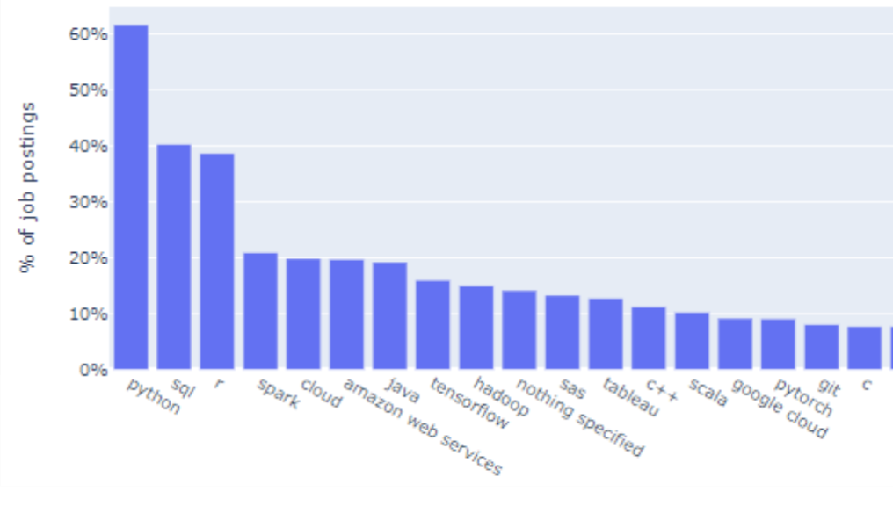
Tools Employers are Looking for
What are the In-Demand Skills for Data Scientists in 2020

Slide 4
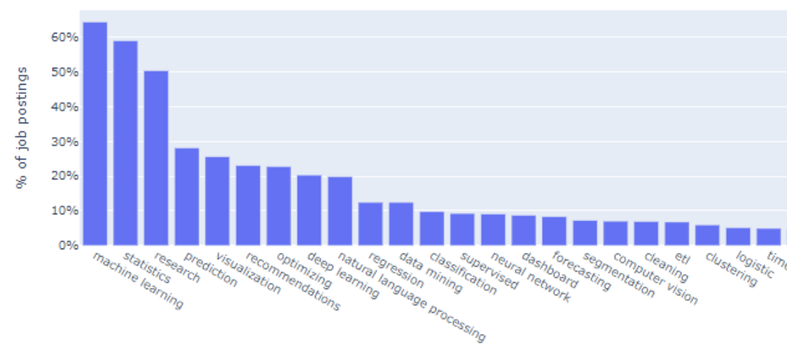
Skills Employers are Looking For
What are the In-Demand Skills for Data Scientists in 2020

Slide 5
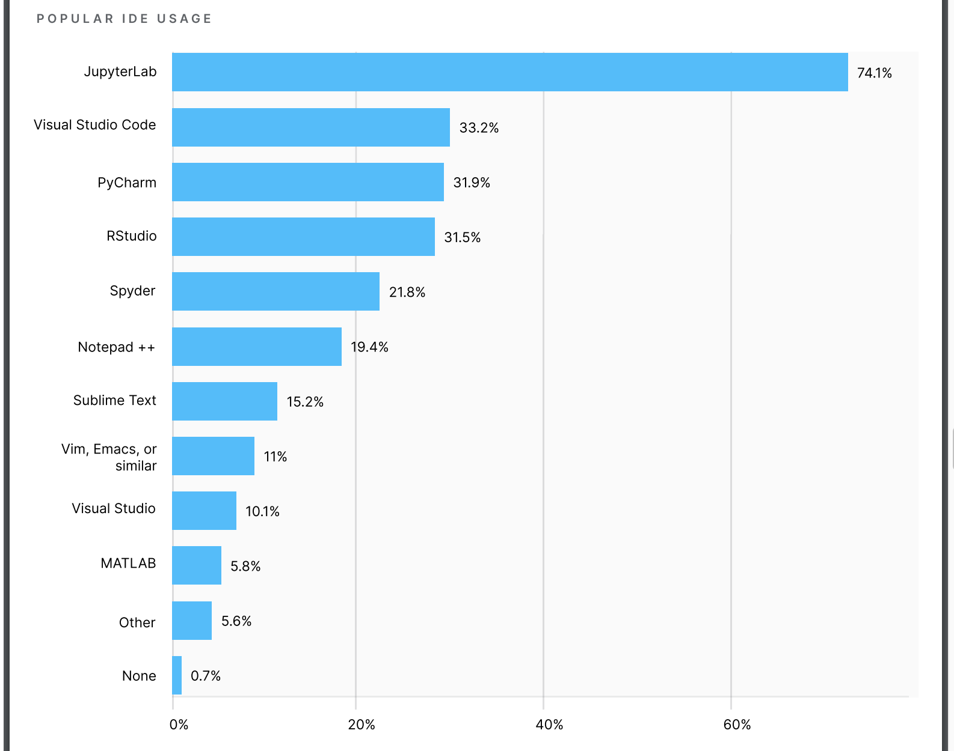
IDE Usage
State of Data Science and Machine Learning 2020

Slide 6
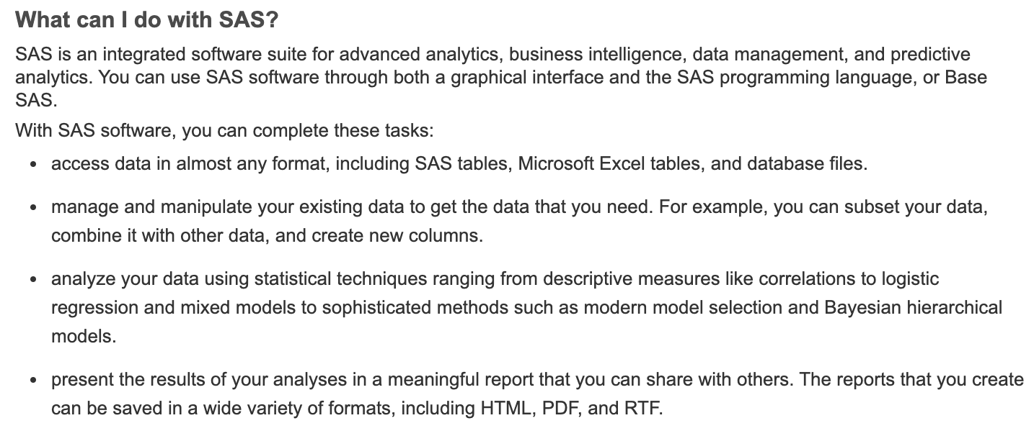
SAS
Founded in 1976 – 44 years ago
Used by almost every Fortune 500 Company
Thousands of SAS jobs on Indeed.com for example
Astounding breadth of capability

Slide 7
Python
Python is a programming language.
Free and Open Source Software (FOSS)
Extended by a vast library of packages
From PyPi
Used extensively for Data Science
Libraries exist to support almost every human endeavor

Slide 8
Software Installation
Anaconda: Easiest way to get a full-featured Python install
https://www.anaconda.com/products/individual#Downloads
Java: Required for SASPy
https://java.com
SASPy: Python library for SAS/Python connection
Launch Anaconda
Launch JupyterLab
File -> New -> Terminal
conda install saspy

Slide 9
REPL
Read
Execute
Print
Loop

Slide 10
Configure SASPy
Create ”sascfg_personal.py”
Create “.authinfo”

Slide 11


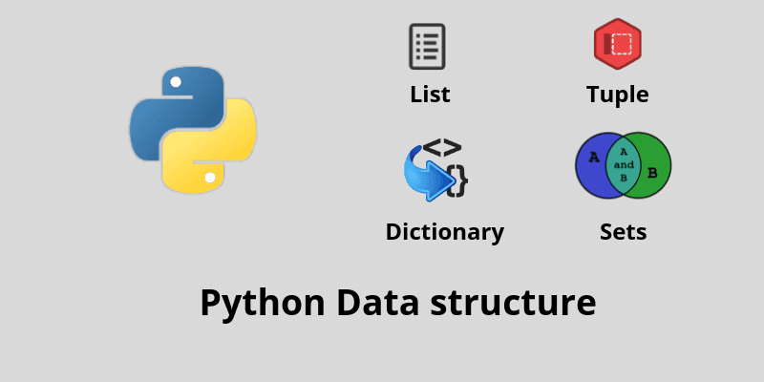

Python Data Structures
z

Slide 12
Literals Notations for constant values
String Literals
Unicode
1-4 bytes per character
”Hello”
’Hello’
f”Hello, I’m {name}”

Slide 13
Literals Notations for constant values
Byte Literals
1 byte per character
b”Hello”
b’Hello’
B”Hello”
B’Hello’

Slide 14
Literals Notations for constant values
Integer Literals
42
True or False
0xFFDA0
0b01001
0o1743

Slide 15
Literals Notations for constant values
Floating Point Literals
42.
3.14
.031
2.99792e8
1_000_000

Slide 16
Literals Notations for constant values
Imaginary Literals
3.14j
10.j
10j
.001j
1e100j
3.14e-10j
3.14_15_93j

Slide 17
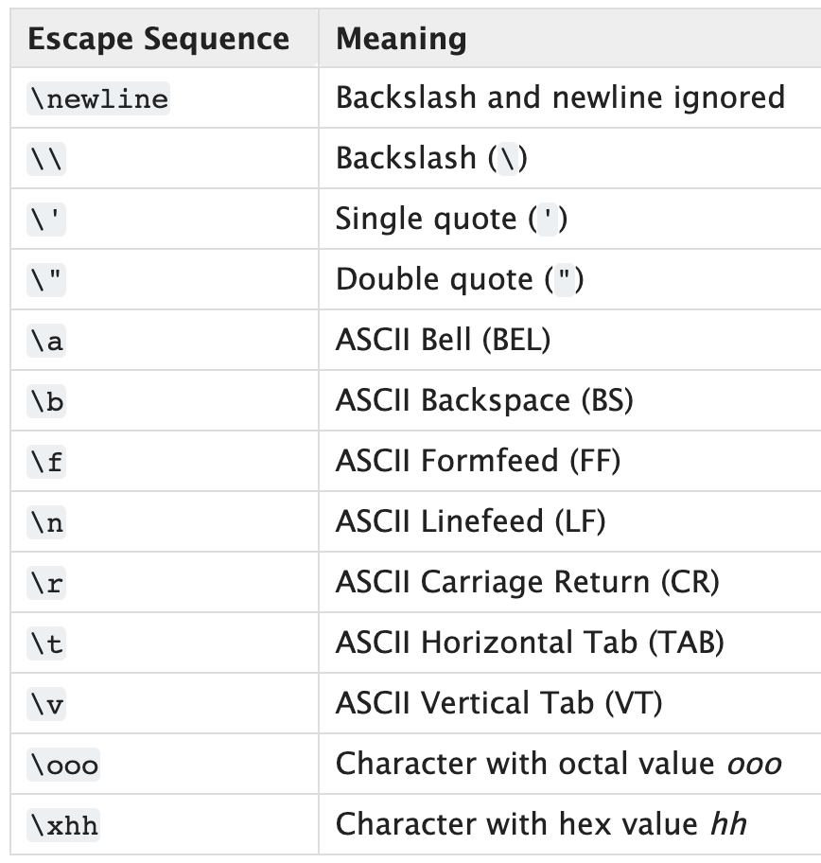
Escape Sequences
z

Slide 18
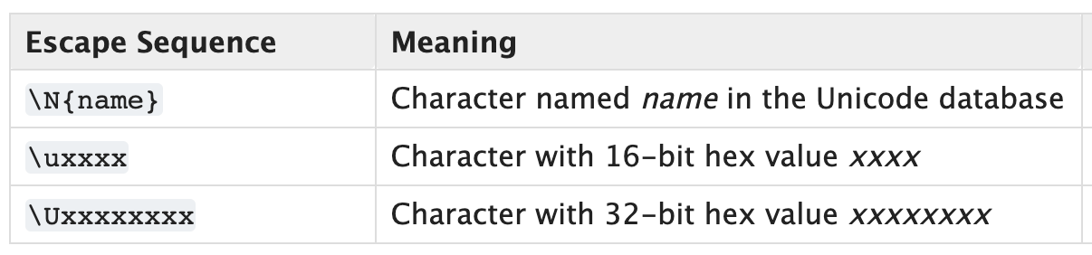
Escape Sequences
z

Slide 19
Numbers
Python

Slide 20
Types of Numbers
Integer (int)
Float (float)
Complex (complex)

Slide 21
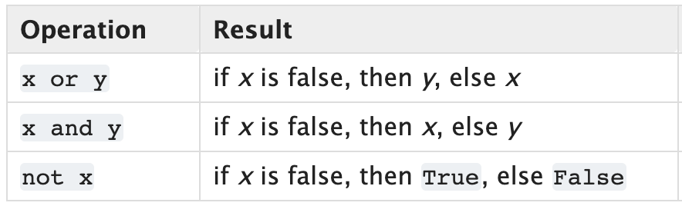
Boolean Operators

Slide 22
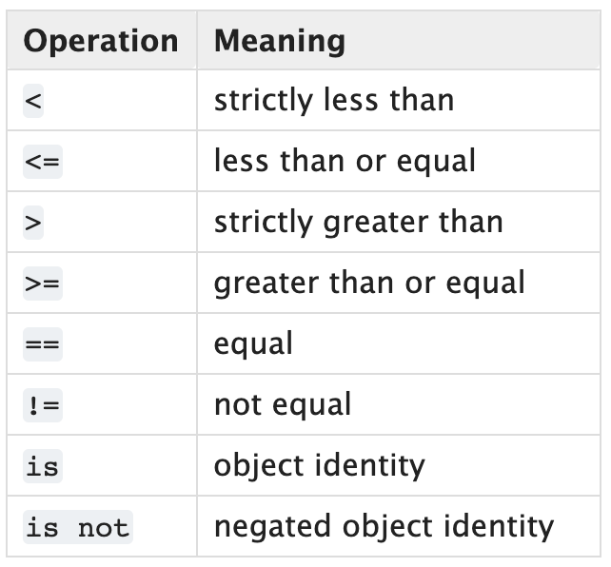
Comparisons

Slide 23
Sequences
Python

Slide 24
Sequences
Finite ordered sets of N items
Indexed by non-negative integers: 0, 1, …, N-1
len() returns number of items N
Slicing a sequence ’seq’
seq[i:j] selects all items between i and j-1
Extended slicing with a ”step”
Seq[i:j:k] selects items at k intervals between I and j-1

Slide 25
Sequence Types
There are three basic sequence types
list
tuple
range

Slide 26
Immutable Sequences (cannot be changed)
Strings
A sequence of Unicode in range of U+0000 to U+10FFFF
‘Hello World’
Tuples
A sequence of arbitrary Python Objects separated by commas
4, ‘four’, 3.14 often written with optional parens (4, ‘four’, 3.14)
Bytes
Array of 8-bit bytes, integers 0 to 255
b’Hello World’

Slide 27
Mutable Sequences (can be changed)
Lists
Sequence of arbitrary Python objects, separated by commas in [ ]
[4, ‘four’, 3.14] brackets required
Byte Arrays
Like immutable bytes objects but mutable
Only created with bytarray() constructor

Slide 28
Sequence Operations
z

Slide 29
Mutable Sequence Operations
z

